Slide 1


Plymouth Family Hubs and Early Help Plymouth Family Hubs | Facebook www.plymouth.gov.uk/family-hubs
Kirsty Mole – Emerging Family Hub Lead
kirsty.mole@larkcluster.co.uk
Barry Mountstevens – Senior Project Manager
Barry.mountstevens@plymouth.gov.uk

Slide 2
What is a Family Hub
The concept of Family Hubs is part of a broader effort to enhance early intervention and preventative services. Family Hubs often collaborate with local schools, health services, and voluntary organisations to deliver a comprehensive range of support.
Family Hubs provide a virtual offer and community-based centres designed to offer integrated services to families, particularly those with children aged 0-19, or up to 25 for those with special educational needs and disabilities (SEND).
Family Hubs provide a single point of access for various support services, including parenting support, early childhood education, health services, employment advice, and housing assistance.
The goal is to simplify access to help and resources, ensuring families receive coordinated and effective support tailored to their needs​.
By bringing together different services under one roof, Family Hubs aim to address issues such as social isolation, financial hardship, and developmental delays in children more effectively. They play a crucial role in improving outcomes for children and families, fostering a supportive community environment, and reducing the need for more intensive interventions later​.
Overall, Family Hubs strive to make it easier for families to navigate and access essential services, thereby promoting well-being and resilience within the community

Slide 3
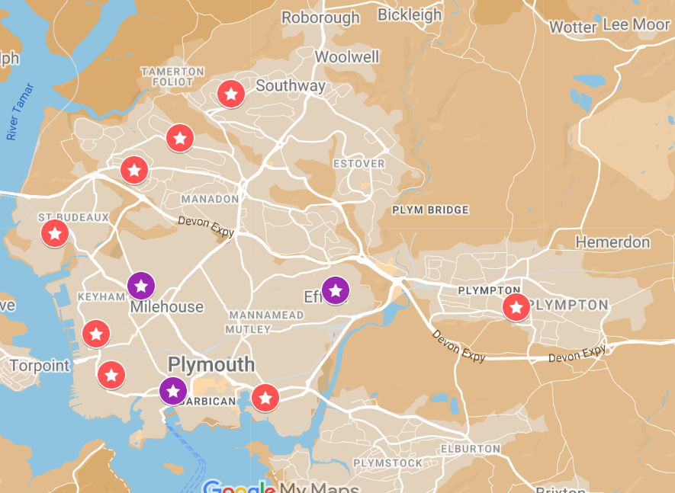
Where are the Family Hubs?
Four Greens Community Hub, Whitleigh, PL5 4DD (Barnardos)
Four Woods Family Hub, West Park, PL5 2LN (Barnardos)
Green Ark Family Hub, Devonport, PL1 4DW (AfC)
High View Primary School, Efford, PL3 6JQ (Barnardos)
Morice Town Family Hub, Morice Town, PL2 1RJ (Lark)
Nomony Family Hub. Cattedown, PL4 0PA (Barnardos)
Rees Family and Wellbeing Hub, PL7 2PS (Barnardos)
Southway Family and Wellbeing Hub, PL6 6TB (Barnardos)
The Barn Family Hub, Barne Barton, PL5 1EJ (Barnardos)
Emerging Family Hubs
North Prospect, PL2 (Lark)
Manor Street Family Hub, PL1 1TL (AfC)
Barnardos - Tracy Tucker
tracy.tucker@barnardos.org.uk
LARK - Kirsty Mole
kirsty.mole@larkcluster.co.uk
Action For Children (AfC) - Clare Wasey Clare.Wasey@actionforchildren.org.uk

Slide 4

‘The right support at the right time in the right place’
Our Vision for Early Help
A city where children and their families can ask for and receive help early, from people they trust. Where services connect to build supportive relationships around families and communities in order for them to thrive. With attention to diversity and aspects of inequality to ensure equitable life chances for our children.
Early intervention regardless of the child or young person's age
Early to respond when problems emerge, or re-emerge
Be able to help prevent concerns getting worse and avoid the need for statutory intervention
Support in school, home and community through a graduated approach
Notes:
Connecting with communities, building on strengths to allow children to grow safe and well within their family networks. This will rely on a culture shift.
co-location vs integration ask a conversation.

Slide 5
Current Landscape
Plymouth Family Hubs have launched 8 Family Hubs, We have 2 Family Hubs to follow and additional venues have requested to become an outreach site or partner Family hub site
Plymouth Family Hub network has grown to over 120 affiliated organisations to help support Children, Young People and families to get the help they need, when they need it from a place they can access.
Plymouth Family Hubs have a growing membership base of 20,000 families
In 2024 (January to August) Plymouth Family Hubs have supported 1454 children to receive enhanced support.
In 2024 the Family Hubs supported 50% of the families they engaged with to Level 3 alongside CSC. 15% of these families having an onward referral
Family Hubs have staff trained in a variety of courses such as GCP2, IAPT, Outcome Stars, VIG and PEEP
328 Families have attended a course delivered or facilitated by the Family Hubs so far in 2024 (Jan to Aug)
Family Hub staff coordinate, deliver or assist with 267 groups each week
Family Hubs have staff at Derriford Hospital supporting families within the NICU ward
Family Hubs have staff in MASH supporting PCC Front Door

Slide 6
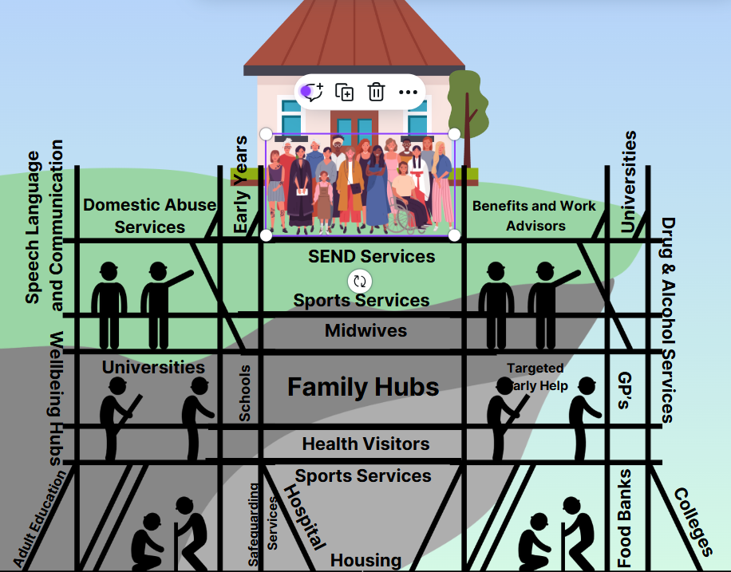
Family Hubs
Parenting Programmes
Stay and Play Groups
Dad’s Groups
One to one outreach support – TAM , Early Help
Grants, Foodbank, Clothing, Uniform, Toys, Baby basics
Access to – Counselling, money advice, housing, befriending
Dental advice, stop smoking, weight management
Breastfeeding, breast pumps, latch on support, weighing

Slide 7
Whats Next?
What types of challenges do families within your school community face that could be addressed through early intervention or Family Hub services?
How effective do you feel current communication channels are between your school and support services like Family Hubs or Early Help?
What could be improved?
Are there any particular gaps in mental health or well-being support for students that you believe need addressing?
How can Family Hubs and Early Help services collaborate with your school to better support students transitioning between key stages?
In what ways could partnership with local services improve student wellbeing and engagement within your wider school community?

Slide 8
How Can Family Hubs Help You?
Parental Engagement and Support – Schools can sometimes struggle to engaging parents, especially when discussing complex SEN needs. Family Hubs can bridge this gap by offering parenting programs, workshops, and one-on-one support to help parents understand and support their child’s development.
Early Identification and Intervention – Many SEN needs go unidentified in early years. By collaborating with Early Help and Family Hubs, schools can benefit from early screening, developmental checks, and referrals, which are crucial for early diagnosis and support.
Addressing Behavioural and Emotional Issues – SENCos frequently handle behavioural challenges that impact learning and social interactions. Early Help can offer family-based interventions and strategies to address these issues, improving school behaviour and reducing classroom disruptions.
Coordination with Health and Social Care – SENCos work with various agencies for children with complex needs. Family Hubs could streamline this coordination, creating a single access point for schools to communicate with social workers, health visitors, and other support staff.
Specialist Training for School Staff – Many teachers may need further training in areas such as autism, ADHD, and other SEN topics. Family Hubs and Early Help services can play an active role in raising awareness of these training opportunities, as well as delivering select in-house sessions to enhance skills. Additionally, Family Hubs can facilitate targeted workshops, equipping school staff with practical, hands-on skills for effectively supporting SEN students in the classroom.

Slide 9
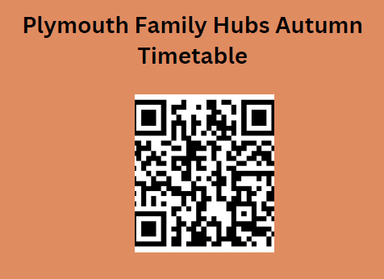
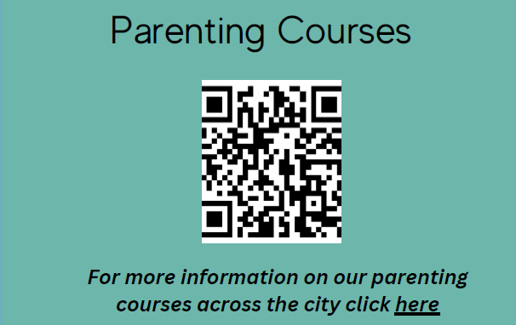
Find out more
www.Plymouth.gov.uk/family-hubs

Slide 10

Questions

